Slide 1
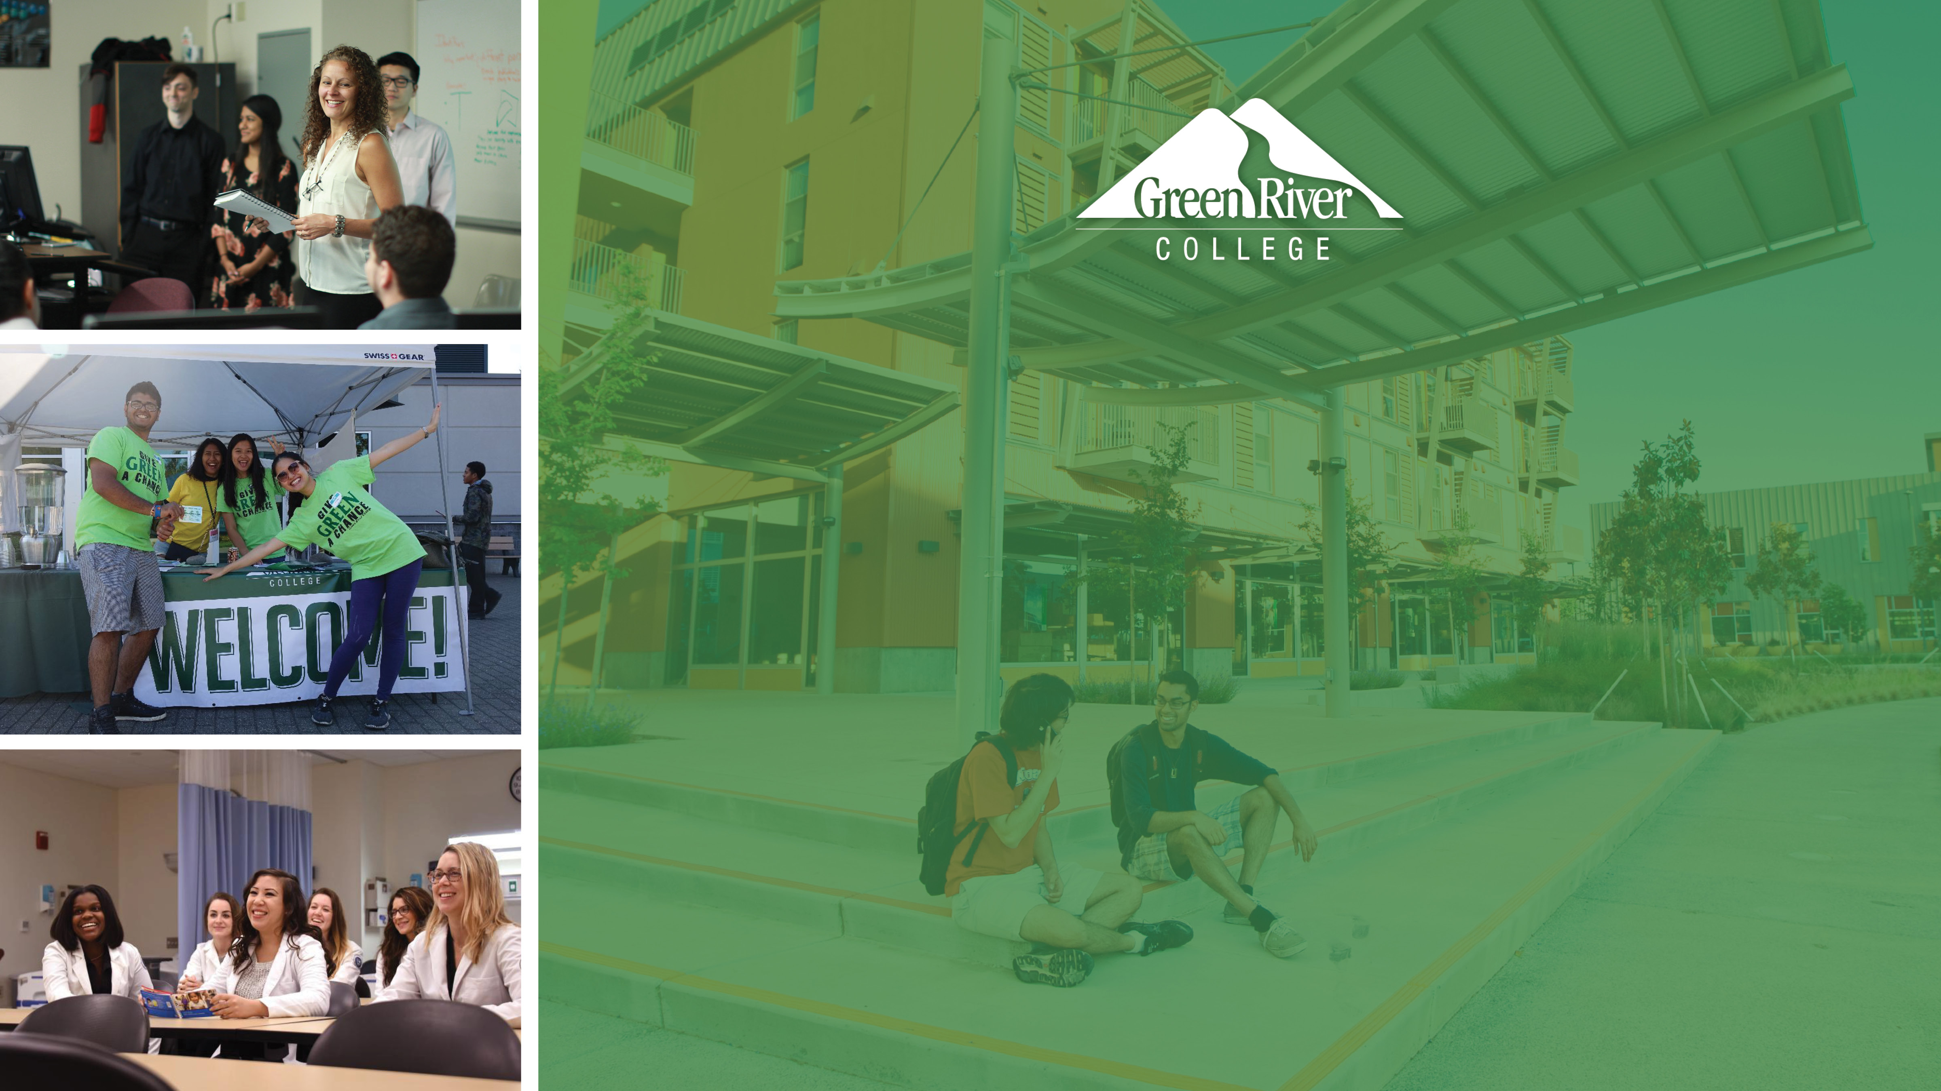
Equity-Centered Strategic
Visioning and Planning
Town Hall Meeting
March 2, 2021

Slide 2
Agenda
Welcome and Introductions
Project Overview and Status
Facilitator Presentations
Break Out Groups
Facilitators Report Back
Next Steps

Slide 3
Project Overview and Status
Notes:
This is a moment for celebration. MIG has done many strategic plans with community colleges and this one has just been exceptional in the
The commitment from your leadership
The participation form the College community – more than any other process
The love for the College and commitment of staff and faculty to the success of the students, we have been so energized and hopeful in these really challenging times
The commitment to embed equity into the plan and have the difficult conversations to make that a reality

Slide 4
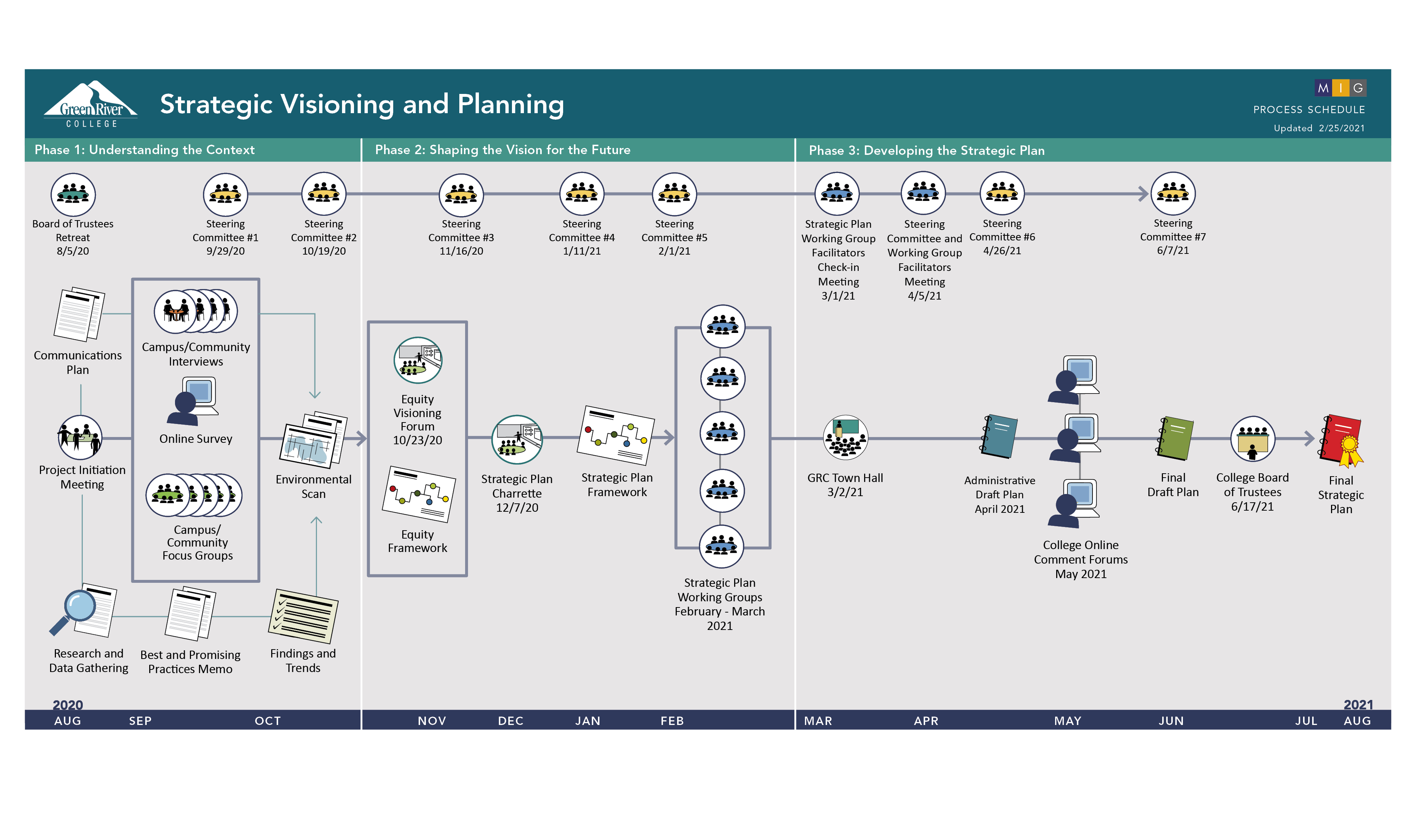
Notes:
We have been on a journey

Slide 5
Campus Community Involvement
Steering Committee: 34 members representing all campus constituencies
11 individual stakeholder interviews
45 participants in 3 Focus Groups:
  16 participants in Faculty / Staff Focus Group
  17 participants in External Community Focus Group – representing civic, business and community organizations
  12 participants in Student Focus Group
610 respondents to Online Survey
Over 200 participants in Equity Visioning Forum
Over 150 participants in Strategic Planning Charette

Slide 6
Strategic Plan Framework

Slide 7
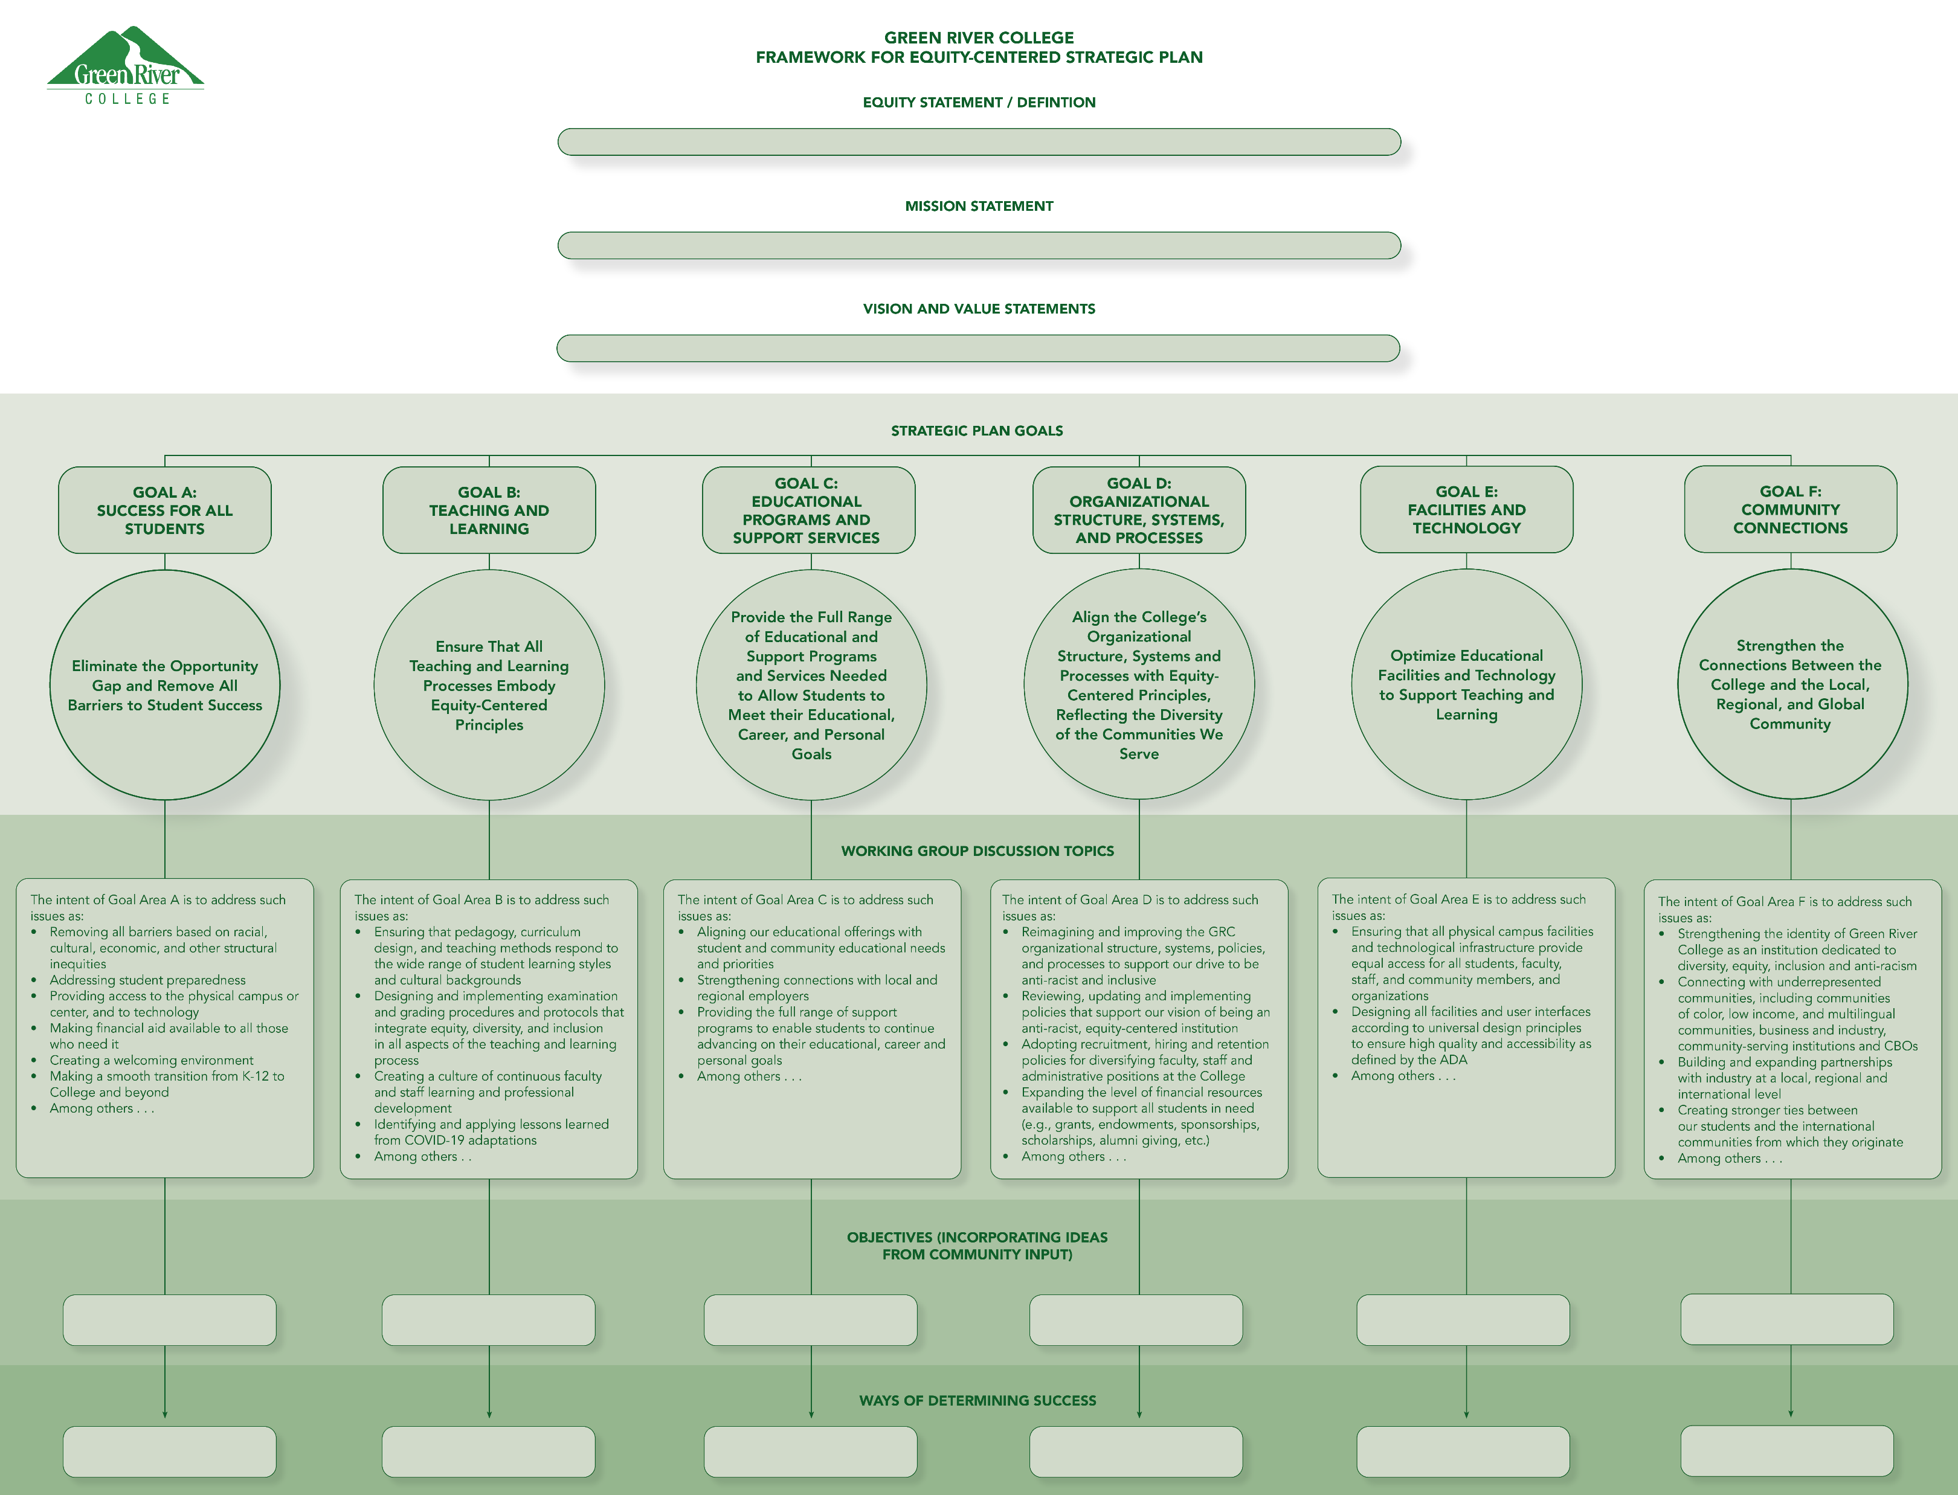
Notes:
Been a verybiterative process. We have nbeen listening, and constantly testing, this is what we heard, does this ring true, does this reflect the input
And we use thay input to shape
This is the elements f your stragic plan

Slide 8
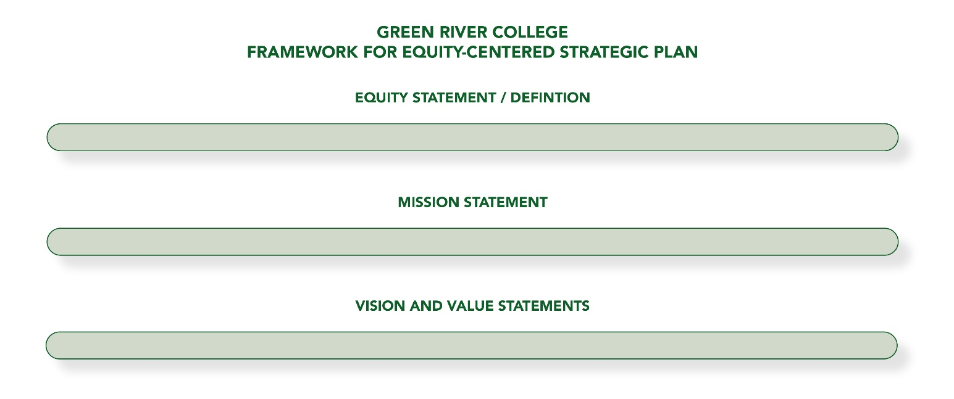

Slide 9
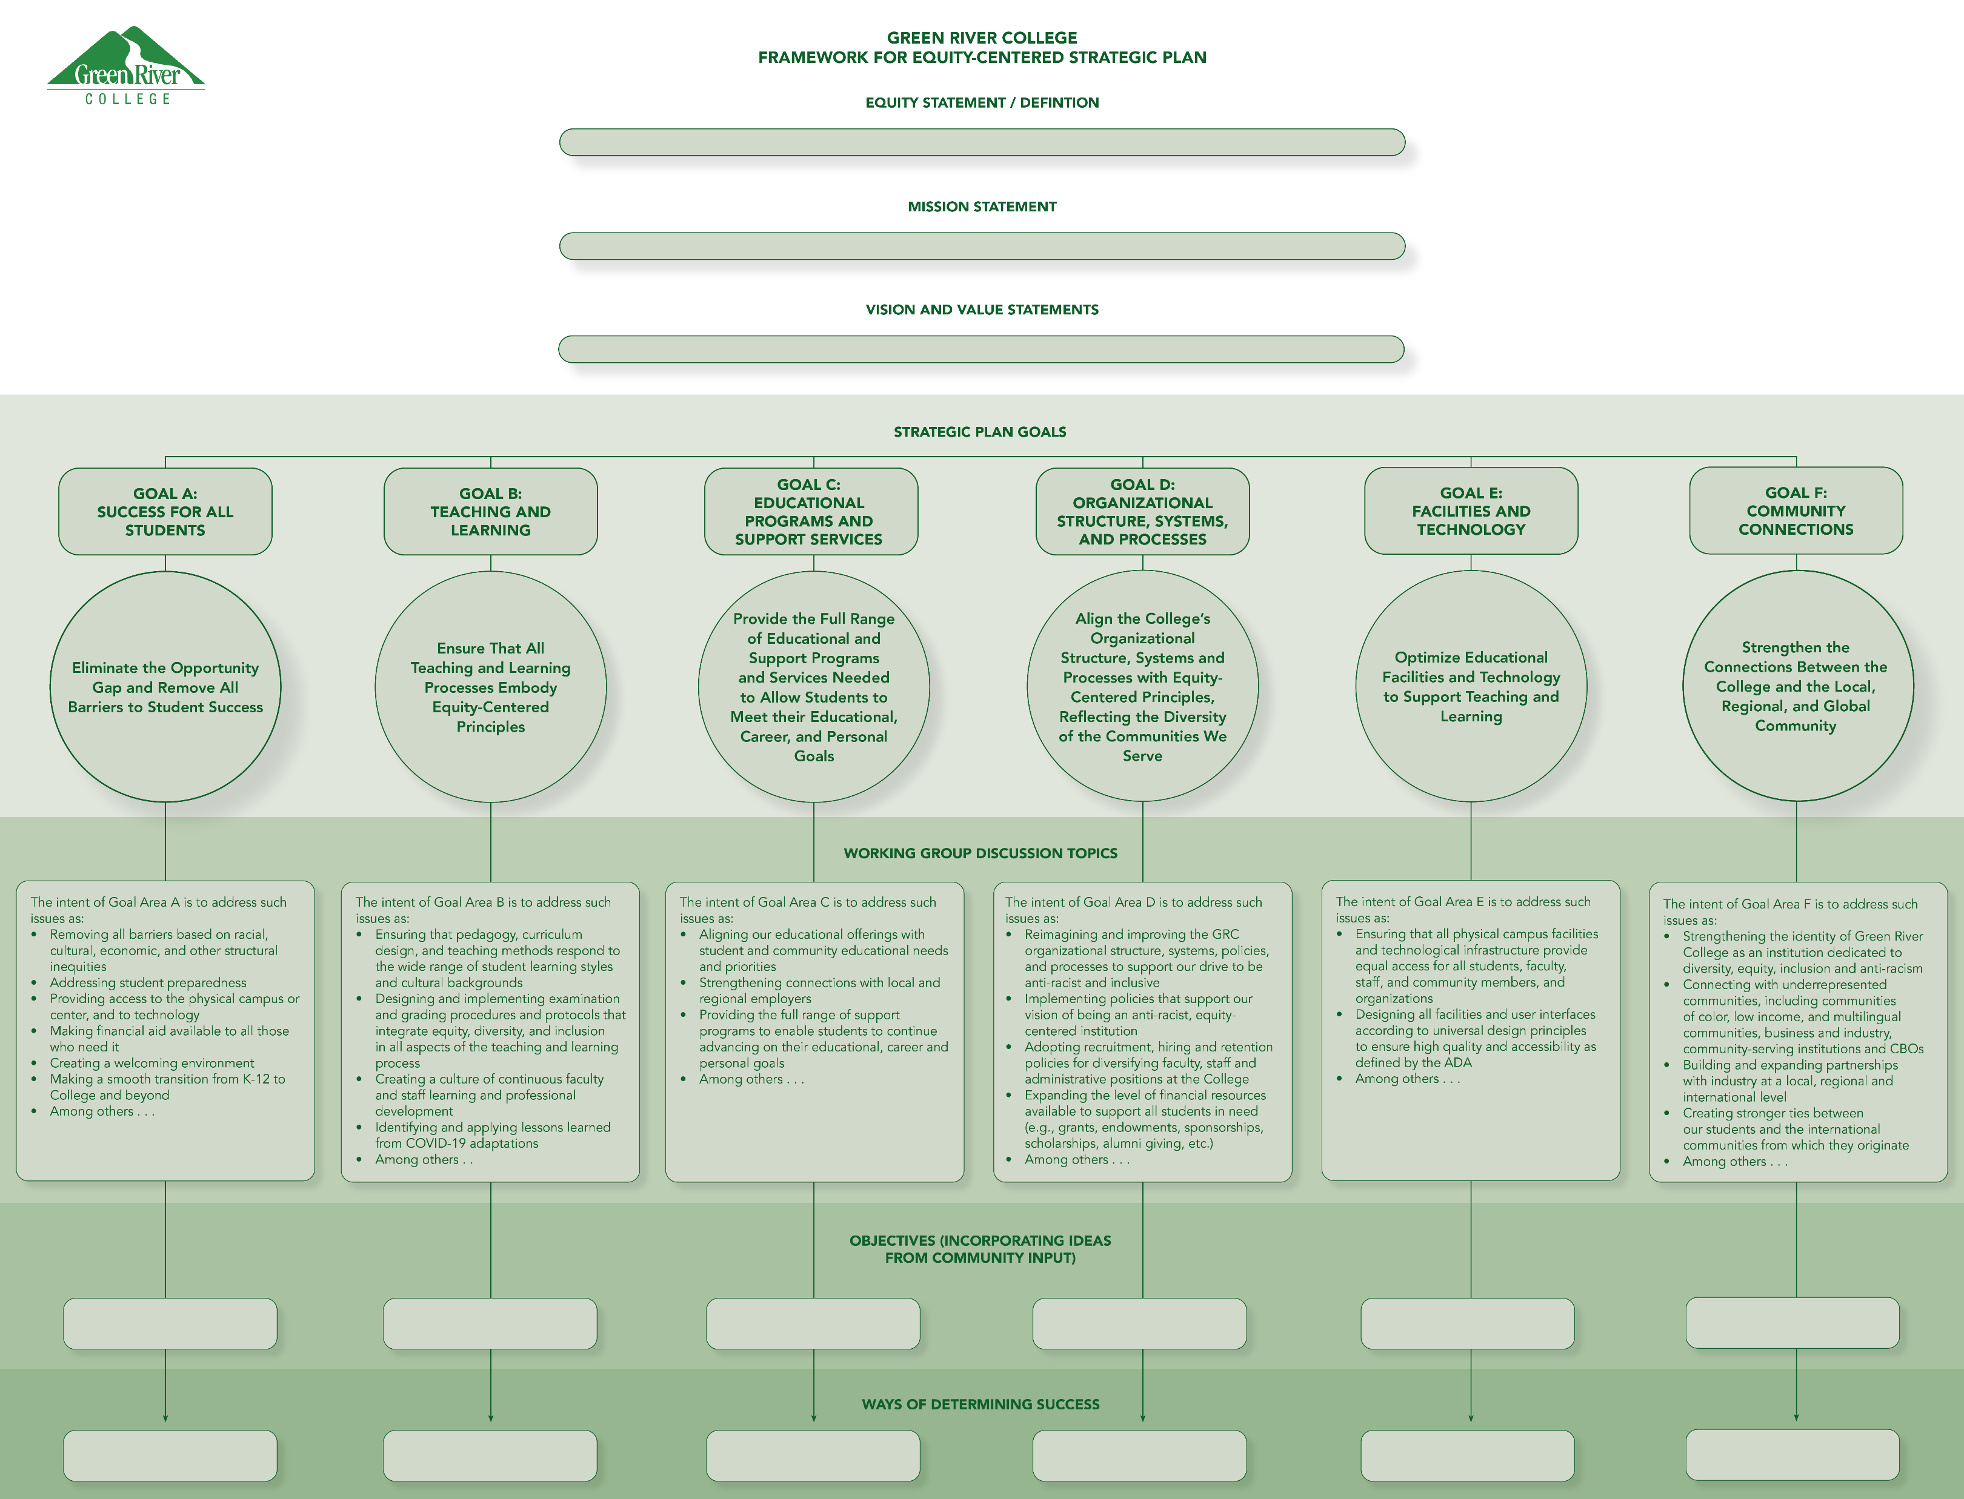

Slide 12
Strategic Plan Goal Statements
GOAL A: SUCCESS FOR ALL STUDENTS | Eliminate the Opportunity Gap and Remove All Barriers to Student Success
GOAL B: TEACHING AND LEARNING | Ensure That All Teaching and Learning Processes Embody Equity-Centered Principles
GOAL C: EDUCATIONAL PROGRAMS AND SUPPORT SERVICES | Provide the Full Range of Educational and Support Programs and Services Needed to Allow Students to Meet their Educational, Career, and Personal Goals
GOAL D: ORGANIZATIONAL STRUCTURE, SYSTEMS, AND PROCESSES | Align the College’s Organizational Structure, Systems and Processes with Equity-Centered Principles, Reflecting the Diversity of the Communities We Serve
GOAL E: FACILITIES AND TECHNOLOGY | Optimize Educational Facilities and Technology to Support Teaching and Learning
GOAL F: COMMUNITY CONNECTIONS | Strengthen the Connections Between the College and the Local, Regional, and Global Community

Slide 13
Facilitator Presentations

Slide 14
Equity Statement
Mission, Vision, & Values

Slide 15
DRAFT - Equity Statement
The Green River College Promise:
We commit to being an anti-racist institution and require all students, faculty, and staff receive the access, resources, and services needed to achieve their educational, career, and personal goals. Green River College makes social and economic justice, equity, and inclusion our first and foremost priority. [our highest priorities]
The Green River College definition of equity includes, but is not limited to, race, economic status, gender, sexuality, ethnicity, disAbility, age, culture, and religion/spirituality. We understand individual needs vary widely, and the effects of discrimination and historical oppression must be taken into account while aiming for equitable opportunities and outcomes for all.
Let this be a call to action to all members of the Green River College Community . . . everyone must contribute to this on-going effort to achieve equity for all.

Slide 16
DRAFT – Mission
Green River College provides a culture of care and commitment to equity that empowers students to achieve their educational, professional, and personal goals and prepares them to contribute to our local and global communities.

Slide 17
DRAFT - Vision
Green River College will be an equity-centered leader in higher education committed to excellence in teaching and learning and to advancing racial and social justice. Green River will be a destination of choice for post-secondary education; first choice in partnership with business and industry; and ranked among the highest in student achievement, closing all opportunity gaps. The racial and ethnic diversity of staff, faculty, and leadership will reflect the diversity of the communities we serve. All members of the college community will feel a strong sense of belonging and, together, build a culture of care. Green River students will be prepared for the global workforce and for civic engagement in an increasingly diverse, interdependent world.

Slide 18
DRAFT – Values
Diversity, Equity, and Inclusion: We examine our own and others’ identities (race, ethnicity, culture, economic status, gender, sex and gender, disAbility, religion/spirituality, immigration status, and age), institutional roles, behaviors, and cultural perspectives, as these relate to power and privilege in the advancement of equity and social justice. We make intentional space for the needs, experiences, ways of communicating, expertise, and leadership of those who are most impacted by systemic and structural inequities.
Culture of Care: We promote love, joy, peace, patience, and kindness in our interactions with students, staff, faculty and community partners in recognition of the human condition.
Accessibility: We acknowledge a wide range of disAbilities, including neurodiversity, and create welcoming, accessible spaces for all in classrooms, campus spaces, and virtual environments.
Accountability: We develop and implement mechanisms for accountability in the hiring process, teaching, student support services, employee relations, financial stewardship, and governance, in order to ensure the meaningful participation of all constituents, anchored in transparency and respectful interactions.

Slide 19
DRAFT – Values (Continued)
Community Engagement: Our multiple campuses in our service areas collaborate to contribute to the educational, economic, and social development of our communities through responsive programs, continuing education, and community and library partnerships.
Growth and Development: We allocate the required resources towards equitable lifelong learning, professional development, and career advancement of our staff, faculty, and students.
Global Civic Engagement: We foster civic responsibility by understanding the critical issues and challenges affecting the diverse communities on our campuses, regionally, in the United States, and around the world. We cultivate respect and empathy for cultural difference, honoring the dignity of multiple languages and being mindful of cultural biases.
Natural Environment: We acknowledge the land on which Green River College sits as the ancestral home of the Coast Salish peoples. We commit to the beautification, preservation, and sustainability of our campus’s natural resources.
Innovation: We seek, create, and adopt innovative programs, policies, practices, operations, and infrastructure that respond to current and future needs.

Slide 20
Goal A: Success for All Students
Eliminate the Opportunity Gap and Remove All Barriers to Student Success

Slide 21
Goal A
  1a) Develop mechanisms to continuously gather feedback from students (including those who have left GRC), employees, and community members to assess needs and barriers
  1b) Create systems for reviewing and acting on this feedback
  (Sources: Equity Visioning Forum, Strategic Planning Charette)
2) Explore opportunities within the four essential pillars of Guided Pathways to incorporate a ‘College Success’ class
(Sources: Strategic Planning Charette, Environmental Scan, Equity Visioning Forum)
Notes:
Collecting, synthesizing

Slide 22
Goal A (continued)
3. Provide support for students’ successful transition into and through college:
3a) Refine placement mechanisms and developmental course sequences in English and math to accelerate students’ progression to college level courses
3b) Maximize the number of courses taught in multiple modalities to accommodate students’ learning styles and schedule
(Sources: Environmental Scan, Equity Visioning Forum, Strategic Planning Charette)
Notes:
Collecting, synthesizing

Slide 23
Goal A (continued)
4. Ensure all students entering GRC have an assigned mentor/support person for the length of their college career
(Source: Strategic Planning Charette)
5. Update campus signage to ensure that it a) reflects students' diverse languages and identities b) helps students locate the services they need
(Sources: Environmental Scan, Equity Visioning Forum, Strategic Planning Charette)
Notes:
Collecting, synthesizing

Slide 24
Goal B: Teaching and Learning
Ensure that All Teaching and Learning Processes Embody Equity-Centered Principles

Slide 25
Goal B
Area 1: Instruction, Professional Development, and Student Support
Systematic Professional Development: Implement a robust, collegewide center of teaching and learning with programming that supports excellence via professional development in high-impact practices for faculty and staff. Ensure that Green River College faculty and staff are trained in equity-centered and inclusive approaches.
(Source: Strategic Planning Charrette)
Balancing Course Modalities: Balance course offering between on-campus, online, and hybrid classes; maximize opportunities for students with diverse course needs while maintaining the best of what we’ve gained during the campus closure.
(Sources: Strategic Planning Charrette, items 8, 9, 12)
Notes:
Collecting, synthesizing

Slide 26
Goal B
Area 2: College Culture and Community Outreach
College Culture: Build a campus culture of trust through routine professional development, mentorship, and relationship building for all faculty and staff; encourage communication, self-reflection, sharing of stories, and safe spaces from which to fight oppression.
(Sources: Strategic Planning Charrette, items 17, 19, 20; 21, 23, 24, 25, 37, 45, and 47; Equity Visioning Forum, item 18)
Community Connections: Increase and deepen connections with our external partners and communities, including K-12, to understand their diverse needs so that the college can (1) link student instruction to diverse community needs and (2) provide faculty and staff training and support with input from different groups who focus on equity and social justice.
(Sources: Environmental Scan—Key Stakeholder Interviews, item 7; Equity Visioning Forum, items 28 and 44; Environmental Scan—External Focus Group item 29, Strategic Planning Charrette, items 42 and 43)
Notes:
Collecting, synthesizing

Slide 27
Goal B
Area 3: Hiring & Labor
Area 4: Assessment & Operations
Hiring, Retention, Labor and Compensation: Actively push for diverse applicant pools for job opportunities, support faculty and staff diverse identities in the face of scrutiny by students or other community members and ensure that faculty and staff have equal opportunities for equal compensation of labor. Assess and track retention of underrepresented staff and faculty, especially staff and faculty of color.
(Sources: Equity Visioning Forum item 18; Strategic Planning Charrette, items 17 and 47).
Assessment and Operations: Develop Green River College operations with transparency, openness, diversity, equity, and inclusion in mind. Break down silos across areas. Assessments of college programs and departments should include measures of diversity, equity, and inclusion.
(Sources: Environmental Scan—Key Stakeholders, items 13 and 27; Strategic Planning Charrette, items 525, 37, 38, 39, 46, 48).
Notes:
Collecting, synthesizing

Slide 28
Goal C: Educational Programs and Support Services
Provide the Full Range of Educational and Support Programs and Services Needed to Allow Students to Meet Their Educational, Career and Personal Goals

Slide 29
Overview of Goal C:
Educational Programs and Support Services
Aligning our educational offerings with student and community educational needs and priorities
Strengthening connections with local and regional employers
Providing the full range of support programs to enable students to continue advancing on their educational, career and personal goals
Notes:
Collecting, synthesizing

Slide 30
Goal C
Educational Programs and Support Services
OBJECTIVE 1: Support student pathways and transitions to, through, and beyond at Green River College
OBJECTIVE 2: Streamline student support service delivery and awareness by engaging and educating students, faculty, and staff
OBJECTIVE 3: Build a robust career services department and increase pre-employment activities that prepare all students for professional opportunities and strengthen industry partnerships

Slide 31
Goal C
OBJECTIVE 1:
Support student pathways and transitions to, through, and beyond at Green River College
Activities and Resources
  C.1a. Adopt the Guided Pathways activities and framework at GRC.
  (Source: Equity Visioning Forum, Key Stakeholder Interviews)
  C.1b. Continue to resource and support TS, pre-college, and I-Best programs, and create clear transitional pipelines to degree and certificate programs. (Source: Equity Visioning Forum, Work group C)
  C.1c. Expand ACPL (Credit for Prior Learning) program offerings and access to students (Source: Equity Visioning Forum)

Slide 32
    Goal C
OBJECTIVE 2:
Streamline student support service delivery and
awareness by engaging and educating students, faculty and staff
Activities and Resources
C.2a. Provide every GRC student with an individual educational, financial, and career transition plan based on their personal, educational, and career goals. (Source: Strategic Planning Charette).
C.2b. Strengthen quarterly student progress interventions and notifications - through faculty, advisor, staff, and student-initiated requests for help (advising, tutoring, emergency aid) through one self-service referral solution. (Source: Strategic Planning Charette, workgroup C)
C.2c. Create a campus wide student peer mentorship program to increase student engagement, persistence, and utilization of key resources. FYE style peer mentoring will provide confidence with navigating college technology, resources, and systems. (Source: Equity Visioning Forum)
C.2d. Improve student service delivery through staff and faculty training and educational awareness of campus resources (Source: Workgroup C)

Slide 33
Goal C
OBJECTIVE 3:
Build a robust career services department and
increase pre-employment activities that prepare all students for professional opportunities and strengthen industry partnerships
Activities and Resources
C.3a. Expand and support a career services department that collaborates with student support services, instruction, and industry partners based on student and industry-identified needs. (Source: Strategic Planning Charette)
C.3b. Improve and increase the stackable certificate offerings within CTE programs.(Source: Equity Visioning Forum)

Slide 34
Goal D: Organizational Structure, Systems, and Processes
Align the College’s Organizational Structure, Systems and Processes with Equity-Centered Principles, Reflecting the Diversity of the Communities We Serve

Slide 35
Goal D
D1. Ensure that all recruitment and hiring processes are designed according to equity principles; identify and eliminate inherent biases; increase diversity of GRC faculty, staff, and administrators to reflect the communities and students we serve. (Sources: Student and Internal Focus Groups, Key Stakeholder Interviews, Equity Visioning Forum, Strategic Planning Charette)
D2. Ensure that the employee onboarding and professional development process at the college: HR, divisions, and departments, is setting everyone up for success; and to retain our diverse and unique talent pool. (Sources: Environmental Scan – Interviews, Equity Visioning Forum, Workgroup D)
D3. Ensure that all campuses and branch locations, students and all other constituents are treated equitably and fairly with respect to funding, policies, processes, programs, facility space, and events. (Sources: Student and Internal Focus Groups, Key Stakeholder Interviews, Equity Visioning Forum, Strategic Planning Charette)
Notes:
Collecting, synthesizing

Slide 36
Goal D
D4. The college’s policy making process will be transparent, inclusive and equity-focused. (Sources: Equity Visioning Forum, Strategic Planning Charette, Workgroup D)
D5. Establish a well-defined governance structure with robust employee involvement. (Source: Strategic Planning Charette)
D6. Expand financial resources available to support students with financial insecurities. (Source: Workgroup D)
D7. Create a welcoming environment to promote and affirm equity and inclusion for all who enter our campus, branch locations, and online domain. (Sources: Equity Visioning Forum, Workgroup D)
Notes:
Collecting, synthesizing

Slide 37
Goal E: Facilities and Technology
Optimize Educational Facilities and Technology to Support Teaching and Learning

Slide 38
Goal E
Area 1: Facilities Related Objectives
Identify a designated body, internal or external to the college, that would have the authority and resources to make signage related decisions, which is included in a Facilities Master Plan and future capital projects.
Create clear directional signage alongside our current campus mapping that provides easy to follow directions to major campus locations, allowing individuals to successfully navigate their way to their destination from any entry point on campus.
Clearly list resources within buildings so students, faculty and staff can reliably find locations for classrooms and student support services.
Notes:
Collecting, synthesizing

Slide 39
Goal E
Area 2: Technology Related Objectives
Standardize the online tools that are used to provide support services and facilitate remote work (if possible, to a single platform). Provide robust onboarding, as well as on-going training and support to faculty, staff and students.
Continue to offer events, services and courses in online modalities that allow students and employees access even when in-person interaction is allowed.
Ensure equal access to technology and student support services to individuals with limited access or resources. Identify funding to help mitigate impact to students in need.

Slide 40
Goal F: Community Connections
Strengthen the Connections Between the College and the Local, Regional, and Global Community

Slide 41
Goal F
Objective F.1: The College will strengthen community connections by evaluating and implementing changes to the GRC website and social media outreach. (Source: Strategic Planning Charette)
  Hire an outside firm to evaluate and make suggestions regarding the effectiveness of the Green River website, specifically focusing on ease of communication, navigability, and business interactions. (Source: Strategic Planning Charette)
  Identify and hire a full-time Social Media specialist who will be responsible for creating and maintaining social media accounts demonstrating GRC’s dedication to a quality student experience, diversity, equity, inclusion, and anti-racism. (Source: Equity Visioning Forum)
Notes:
Collecting, synthesizing

Slide 42
Goal F
Objective F.2
The College will implement required equity-focused “customer-service” training for faculty, staff, and administrators.
Identify external, local community partners to assess needs and deliver training.
Develop a database to track completion and evaluate effectiveness and change over time.

Slide 43
Goal F
Objective F.3
The College will establish a central “community focus” office on campus. (Source: Strategic Planning Charette and Equity Visioning Forum)
  Act as a liaison between businesses and the appropriate campus resource and work closely with areas already engaged in this work such as the CTE divisions and Branch Locations. (Source: Strategic Planning Charette and Equity Visioning Forum)
  Develop one or more positions within the CTE or Branch campuses program to accomplish this objective. (Source: Strategic Planning Charette and Equity Visioning Forum)
  Identify and build relationships with businesses and community partners, focusing on meeting the needs of our community. (Source: Strategic Planning Charette)

Slide 44
Goal F
Objective F.3 continued:
  Create GRC ambassadors who will engage regularly with various community partners, including local and international populations. (Source: Equity Visioning)
  Launch student and peer navigation groups that will work in the community to strengthen and develop those partnerships. (Source: Equity Visioning Forum)
  Establish a Community Resource Center to provide resources and services at a free or reduced rate to community members. (Source: Equity Visioning Forum)
  Create a childcare center or ensure viable childcare options for students, faculty, and staff in order to build a culture of intentional relationship building and to center GRC as an integral part of the community. (Source: Equity Visioning Forum)
  Develop a marketing and tracking system to evaluate use and identify potential partners and services.

Slide 45
Break Out Group Discussions

Slide 46
Break Out Discussion Questions
Do you want to confirm or amend any of the objectives?
Do you have ideas for additional specific action-oriented objectives to accomplish this goal and make a difference?

Slide 47
Facilitators Report Back
Break Out Group
Summary Presentations

Slide 48
Next Steps
March 2, 2021

Slide 49
Next Steps

Slide 50
More Information
Strategic Plan Steering Committee Meetings
Check the website for dates
Online Comment Forums in May
To review the draft plan
Board of Trustees Meeting to Review the Final Plan
June 6, 2021
Project Website
https://www.greenriver.edu/strategicplanning/
Notes:
Collecting, synthesizing

Slide 51
Equity-Centered Strategic
Visioning and Planning
Town Hall Meeting
March 2, 2021

